Slide 1
AI & ML – Demystifying the buzz words
Prasanna Kumar

Slide 2



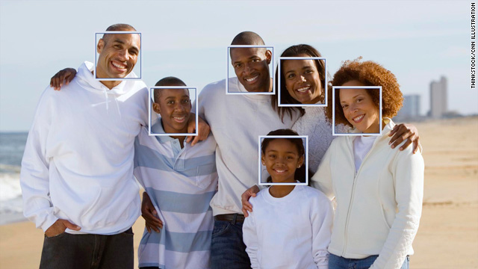
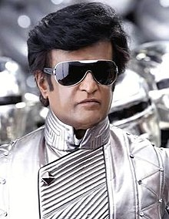

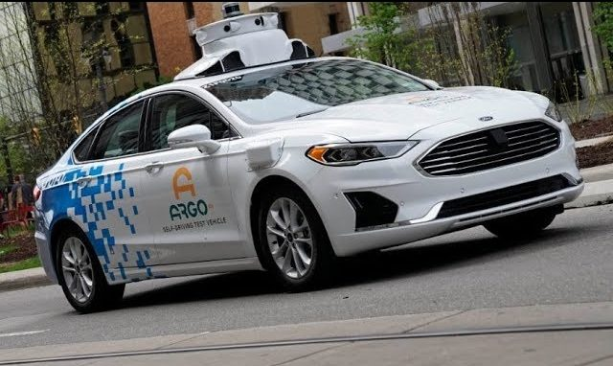

What are some AIs?
An AI is any system exhibiting intelligent traits

Slide 3
Concepts behind these..
Polynomial regression
Neural networks
Support Vector Machines
K-Means algorithm
Recommender systems
Computer Vision
Fuzzy logic
Most of these fall under the umbrella of Machine learning.

Slide 4
So how do machines learn?
What do machines learn?
They learn the correlation between the input and expected output out of a large sample of data it’s been fed
Try out!
https://teachablemachine.withgoogle.com/

Slide 5
Some simple examples
Relationship between
Marketing budget of a company – Actual sales volume of the year
GDP of the country – Annual Automobile sales
House area in sq. ft – Price of the house
Let’s take Marketing Budget vs Actual sales
Sample data
1 Million – 1,200,00 Units
3 Million – 1,600,000 Units
8 Million – 2,600,000 Units
5 Million – ??? Units
Let x be Budget in Millions and y be No of units in 100,000 in a graph

Slide 6
Finding the pattern of data,
Our goal is to figure out hypothesis h(x), a linear equation of x
A linear equation is of the form,
h(x) = mx + c
Substituting our data, we get
12 = m + c
16 = 3m + c
26 = 8m + c
➔ 16 - 12 = 3m – m + c – c ➔ 4 = 2m ➔ m = 2
We get m = 2, c = 10
Our data conforms to the equation, h(x) = 2x + 10

Slide 7
In a gist,
The machine learns the value of m and c for which the deviations of predictions(h(x)) from actual output(y) is minimal. (In this case 0)
Whereas in real life the data is going to be messed up. Example.,
1 Million – 1,000,00 Units
3 Million – 1,800,000 Units
5 Million – 1,900,000 Units
8 Million – 2,700,000 Units
6 Million - ??? Units

Slide 8
The messed up real life data,
It is impossible to solve for a value of m and c that satisfies all these 4 equations.
10 = m + c
18 = 3m + c
19 = 5m + c
27 = 8m + c
How can I make sure that the error of the prediction is minimal?
Assume a value for m and c. Apply in the above equations and compute the deviations
m=2.0, c=10 ➔ 2 + 2 + 1 + 1 ➔ 6
m=2.2, c=9 ➔ 1.2 + 2.4 + 1 + 0.4 ➔ 5

Slide 9
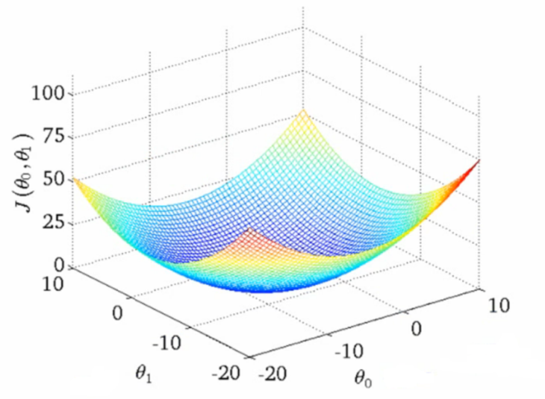
Cost function
Finding the value of m and c for which the error is minimum, it is the optimum solution for h(x). It generalizes our problem statement!
Finding the m and c for minimum error is achieved using a process called Gradient descent
c
m

Slide 10
How do you pictorially represent h(x)
h(x) = mx + c, This is called as a Perceptron.
1
c
+
h(x)
m
x

Slide 11
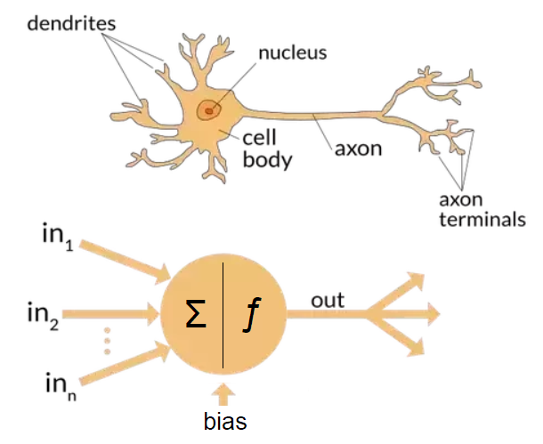
Perceptron vs Neuron
A Perceptron is a mathematical model of a biological neuron

Slide 12
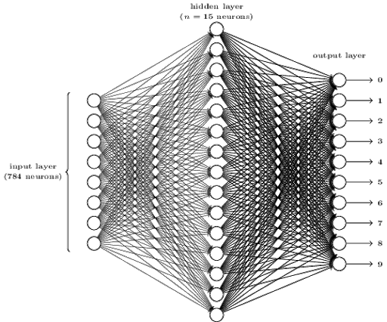
A Hand-written digit recognition network
= 809 Neurons
Number of layers and number of neurons determine the learning capacity of the network (It also takes a long time to train)
Instead of Gradient descent, for Neural networks a mechanism known as Backpropagation is followed for computing the values for the model
PS: A human brain has 86 billion neurons

Slide 13
Variants of Neural networks
Some of the extension of a simple neural network are:
Convolutional Neural Network
Recurrent Neural Network
Long Short Term Memory
Generative Adversarial Network
https://affinelayer.com/pixsrv/index.html

Slide 14
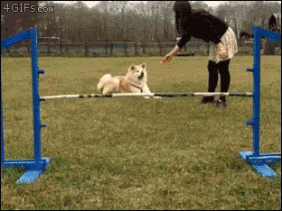
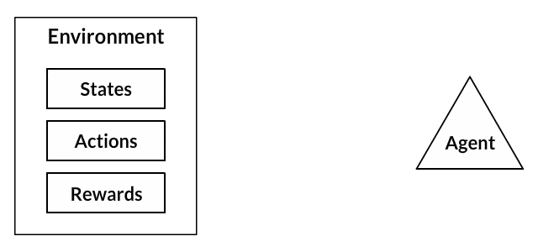
Reinforcement learning
Data driven ML Models are only as good as it’s data
Need to generate new data to reinforce and fine tune the system

Slide 15
Some cool examples,
https://selfdrivingcars.mit.edu/deeptraffic/
https://www.youtube.com/channel/UC0e3QhIYukixgh5VVpKHH9Q/videos
https://gym.openai.com/

